Slide 1
Low RIN, (Quasi-) SM, and High-Speed VCSELs for OI Application
Notes:
各位委員大家好，我是施杰忱，我要報告的研究是：應用於光無線通訊之高速、高亮度、高效率940nm光波段垂直共振腔面射型雷射陣列

Slide 2
Outline
Introduction & Motivation
Ways to low RIN
Our Achievements
Conclusion and Future Work
Notes:
這是我今天的報告大綱。首先，是發展進程及動機
接著是介紹VCSEL理論及我們元件結構
再來會有IET940nm光波段陣列的量測
然後是聯亞940nm光波段陣列的量測結果及單顆元件量測出的特性
最後為未來展望以及結論的部分

Slide 3
Outline
Introduction & Motivation
Ways to low RIN
Our Achievements
Conclusion and Future Work
Notes:
這是我今天的報告大綱。首先，是發展進程及動機
接著是介紹VCSEL理論及我們元件結構
再來會有IET940nm光波段陣列的量測
然後是聯亞940nm光波段陣列的量測結果及單顆元件量測出的特性
最後為未來展望以及結論的部分

Slide 4
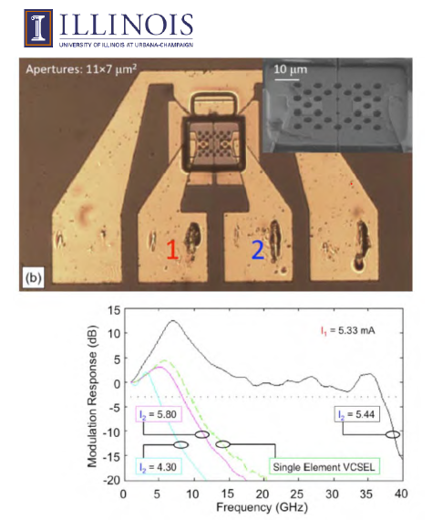
Toward higher Speed : Coupled Cavity (photon-photon resonance !!)
By courtesy of Dr. Daniel M. Kuchta
High-temperature operation is an issue ??
More than 10 dB resonance in measured E-O frequency response Eye pattern will degrade!!
High RIN !!
3dB bandwidth can reach upto37 GHz, but at some special combination of bias currents
S. T. M. Fryslie, M. P. T. Siriani, D. F. Siriani, M. T.
Johnson and K. D. Choquette, IEEE Photon. Tech. Lett., vol. 27,
no. 4, pp. 415-418, Feb.15, 2015
Notes:
在 Illinois 上 此種VCSEL 透過了 Coupled cavity 橫向耦合共振腔設計 來達到37GHz的頻寬，透過特殊的MESA凸台設計，通过减少无源反馈腔中的吸收损耗可以增加耦合强度，來達到約40Gbit/s的傳輸資料量。
但這種元件的頻寬在5mA操作電流的情況下，達到最快的37GHz的強況下，有著一個很大的 Resenate
這種情況下，能夠在高溫還能持續有著高傳輸量的表現嗎?

Slide 5
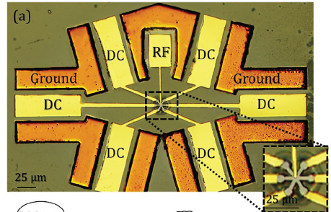
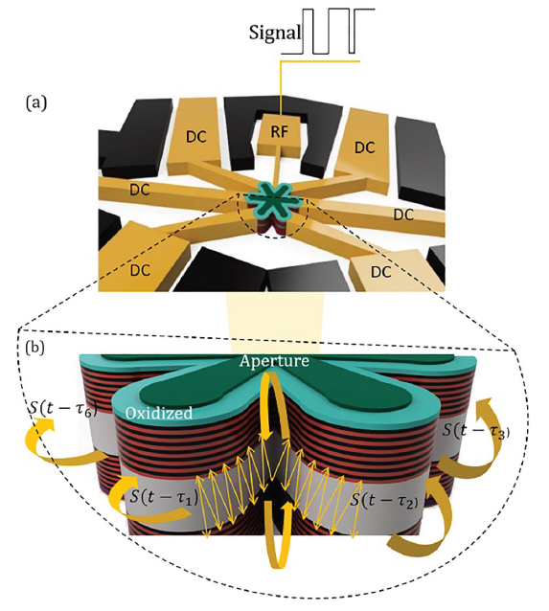
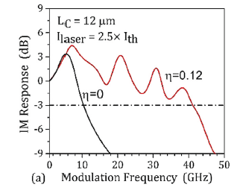
Toward higher Speed :
Hexagonal transverse-coupled-cavity
3dB Bandwidth near 42 GHz
However, no eye patterns (RIN issue ?)
Elham Heidari, Hamed Dalir*, Moustafa Ahmed, Volker J. Sorger and Ray T. Chen
Nanophotonics 2020; 9(16): 4743–4748

Slide 6


Our group previous work
2~3um
Complex modulation format
Room temperature
85$℃$
E-O bandwidth of VCSEL’s is limited ~ 40GHz (How to further increase data rate)
It can reach E-O bandwidth up to 40 GHz @ RT operation which degrades to 32 GHz when temperature increases to 85$℃$(Record-high E-O bandwidth among all reported VCSELs !!).
Ultra-Fast Zn-Diffusion/Oxide-Relief 940 nm VCSELs
Chen-Lung Cheng1, N. Ledentsov Jr.2, M. Agustin2, J.-R. Kropp2, N. N. Ledentsov2, Z. Khan1, and Jin-Wei Shi1*
OFC 2019 © OSA 2019
Notes:
再來是元件的E-O 3dB頻寬，2~3um的元件可以看到他的高頻特性，分別在3mA的操作電流下，達到24~
7mA可以達到40GHz的頻寬，然後在高溫的部分 他的頻寬可以達到32GHz
這個頻寬是目前所知道 vcsel 單顆元件 所到達的最快的頻寬

Slide 7
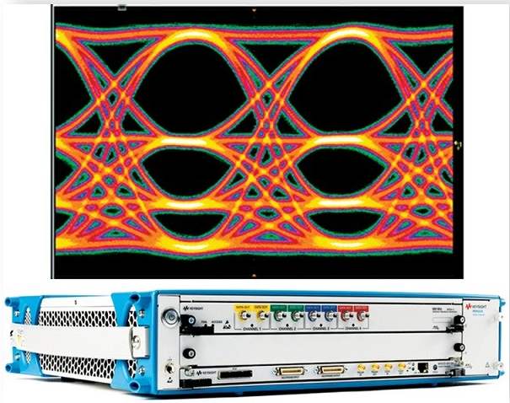
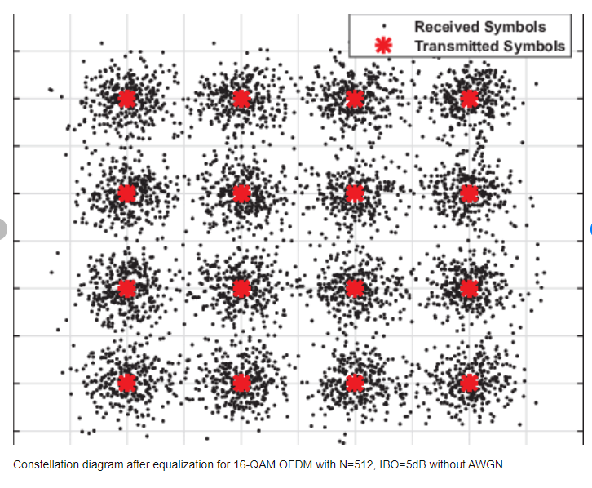
Complex modulation format
Orthogonal Frequency Division Multiplexing (OFDM)
Pulse Amplitude Modulation (PAM)
e.g. PAM4
Relative Intensity Noise (RIN) plays crucial role

Slide 8
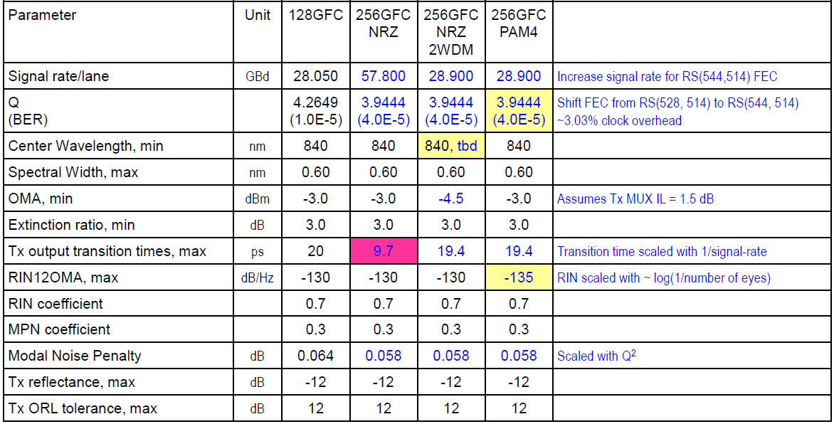
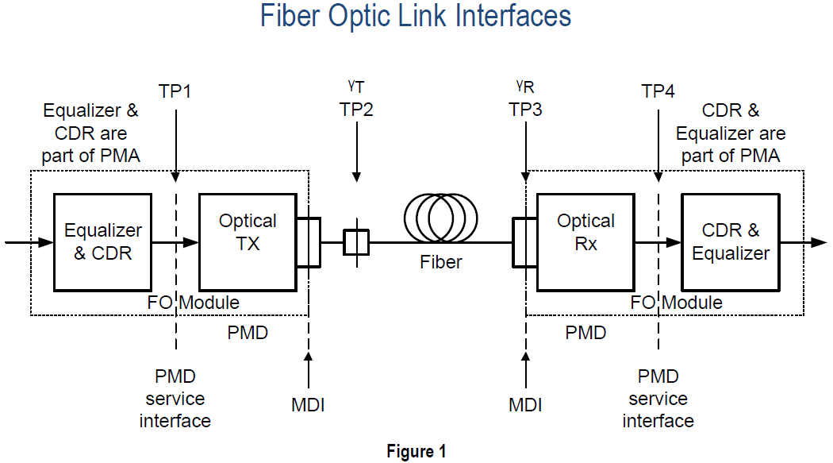
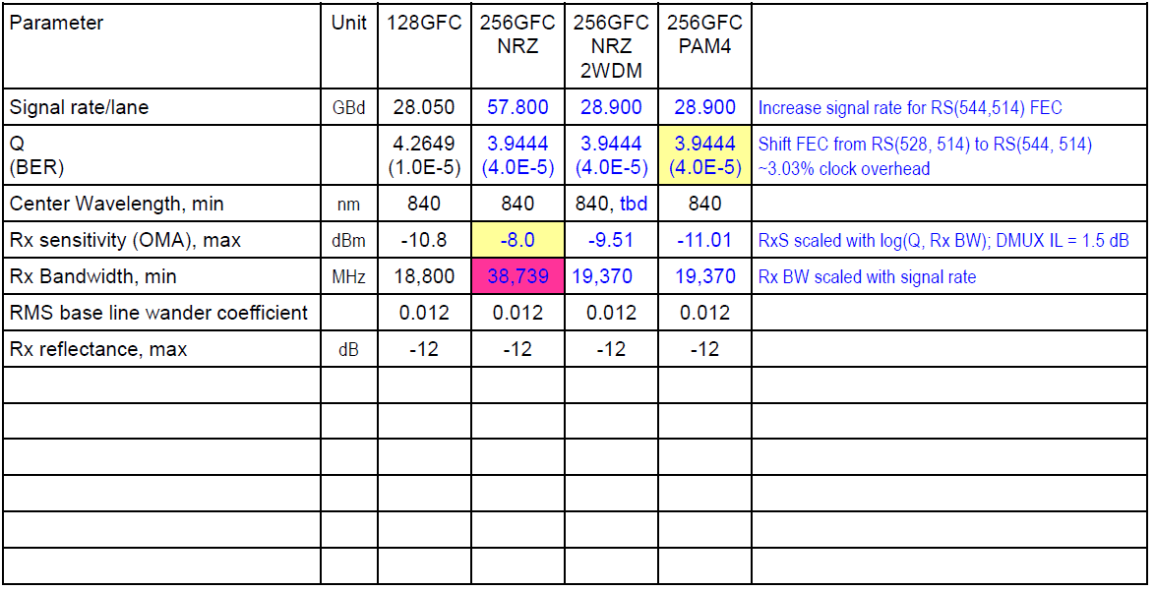
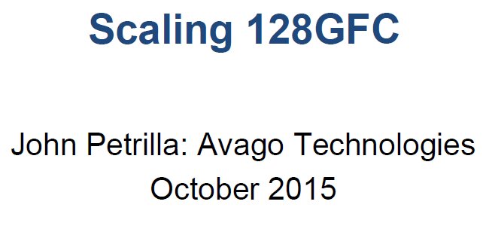
Fibre Channel (FC)
Lower RIN values are highly desirable

Slide 9
Our group previous work: (54 Gbit/sec for 1 km OM4 fiber; low RIN and Quasi-SM)
For SM and low-RIN performances, we need 2-3 um, oxide aperture (high photon density..)
Reliability is an issue….
Notes:
再來是元件的E-O 3dB頻寬，2~3um的元件可以看到他的高頻特性，分別在3mA的操作電流下，達到24~
7mA可以達到40GHz的頻寬，然後在高溫的部分 他的頻寬可以達到32GHz
這個頻寬是目前所知道 vcsel 單顆元件 所到達的最快的頻寬

Slide 10
Outline
Introduction & Motivation
Ways to low RIN
Our Achievements
Conclusion and Future Work
Notes:
這是我今天的報告大綱。首先，是發展進程及動機
接著是介紹VCSEL理論及我們元件結構
再來會有IET940nm光波段陣列的量測
然後是聯亞940nm光波段陣列的量測結果及單顆元件量測出的特性
最後為未來展望以及結論的部分

Slide 11
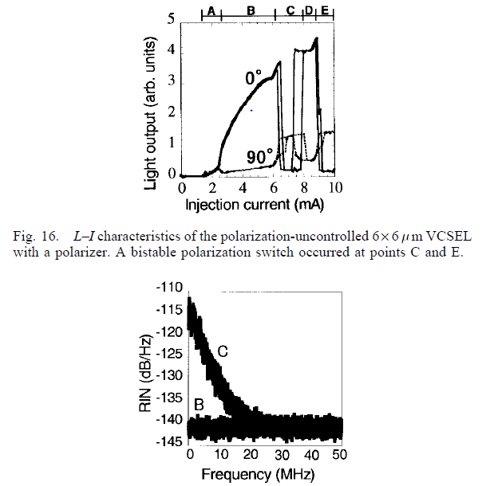
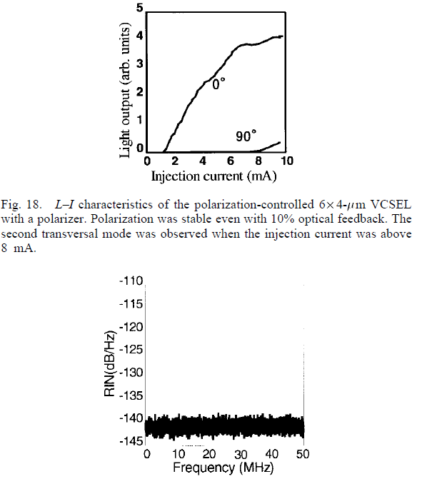
Need of controlled Polarzation-states?
If polarization states can’t be controlled
RIN is more
RIN is caused by energy partition between orthogonal modes
T. Yoshikawa, T. Kawakami, H. Saito, H. Kosaka, M. Kajita, K. Kurihara, Y. Sugimoto, and K. Kasahara, "Polarization-controlled single-mode VCSEL," in IEEE Journal of Quantum Electronics, vol. 34, no. 6, pp. 1009-1015, June 1998, doi: 10.1109/3.678597.

Slide 12
How to achieve single-polarized structure
4 ways to achieve single- polarized structures
Epitaxial-growth on misoriented substrates
Anisotropic side-wall posts
Elliptical Surface Etching of DBR layers
Implementing linear grating on top-most DBR mirrors

Slide 13
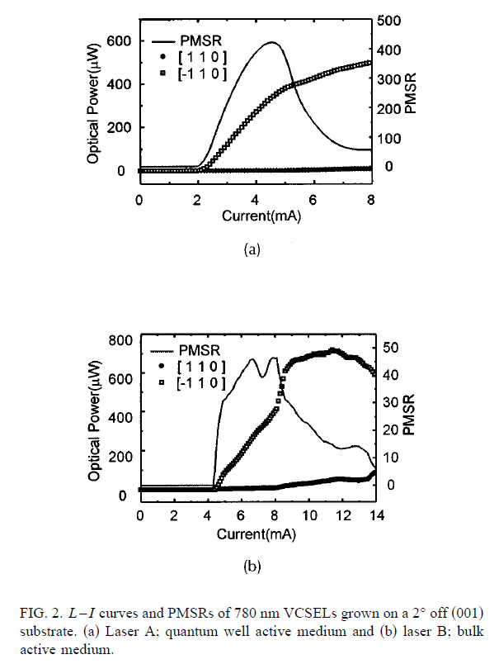
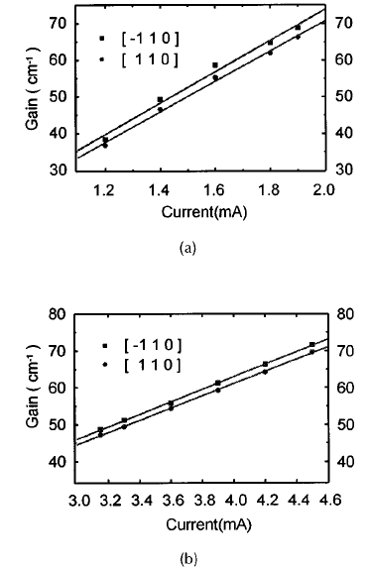
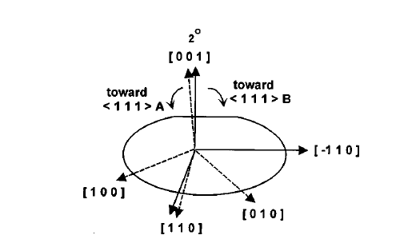
Epitaxial-growth on misoriented substrates
Strong polarization in 011-
780 nm VCSEL grown on (001) GaAs substrate tilted at an angle of 2° towards (111) axis
Better control of polarization states
Young-Gu Jua and Yong-Hee Lee
Hyun-Kuk Shin and Il Kim
Received 28 April 1997; accepted for publication 6 June 1997

Slide 14
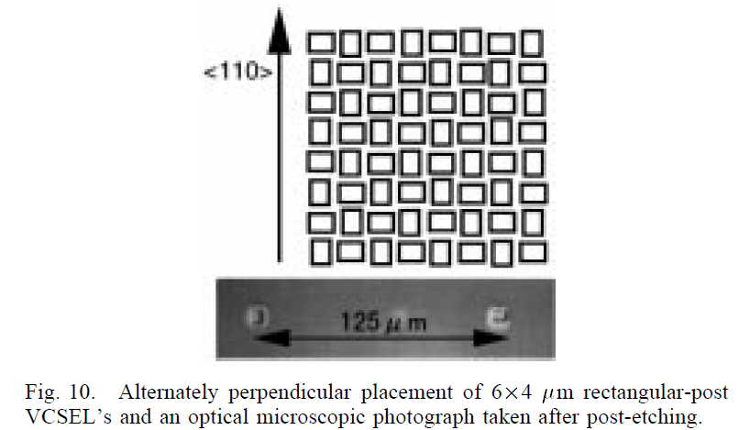
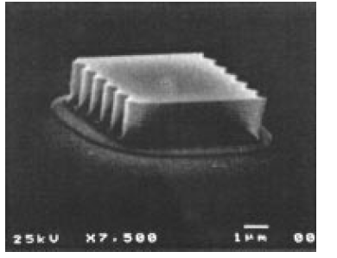
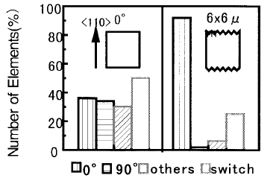
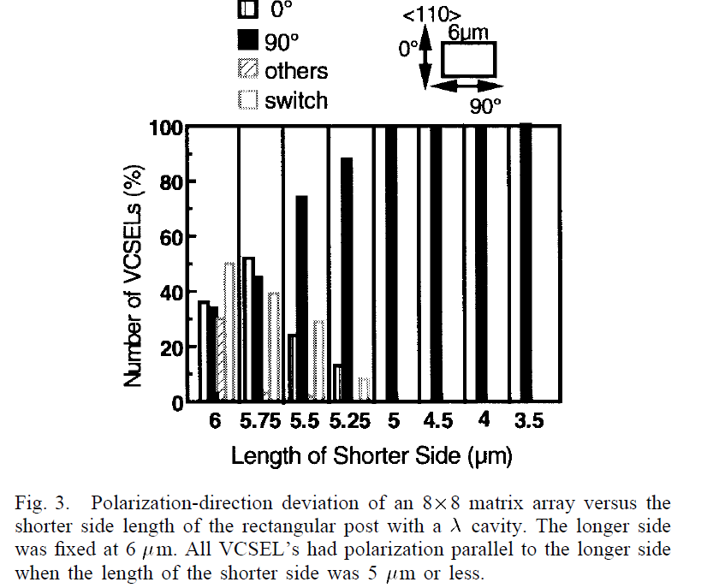
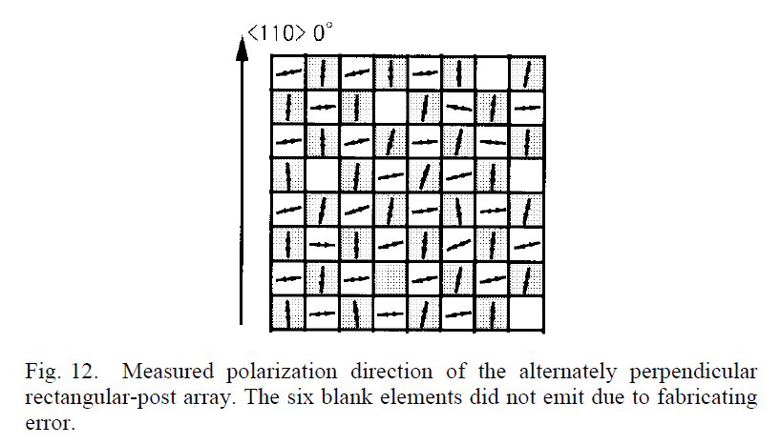
Anisotropic side-wall posts
It will reduce photon lifetime, which results in increase of RIN
Polarization states changes with change in mesa shape
Polarization states will always be along longest axis of rectangular mesa structure
Takashi Yoshikawa, Takeshi Kawakami, Hideaki Saito, Hideo Kosaka, Mikiyasu Kajita,
Kaori Kurihara, Yoshimasa Sugimoto, and Kenichi Kasahara
IEEE JOURNAL OF QUANTUM ELECTRONICS, VOL. 34, NO. 6, JUNE 1998

Slide 15
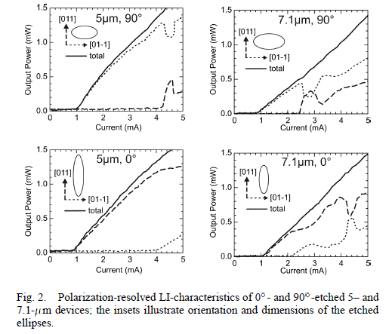
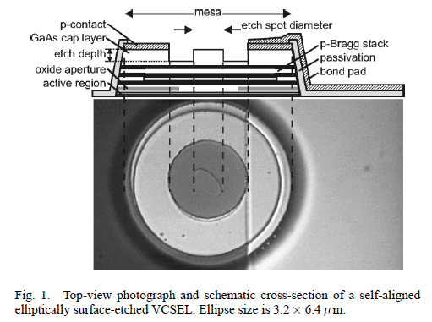
Elliptical Surface Etching of DBR layers
Etching mirror
reduces photon lifetime, which will increase RIN
Show good control in polarization-states
Pierluigi Debernardi, Heiko J. Unold, Juergen Maehnss, Rainer Michalzik, Gian Paolo Bava, and
Karl Joachim Ebeling
IEEE JOURNAL OF SELECTED TOPICS IN QUANTUM ELECTRONICS, VOL. 9, NO. 5, SEPTEMBER/OCTOBER 2003

Slide 16
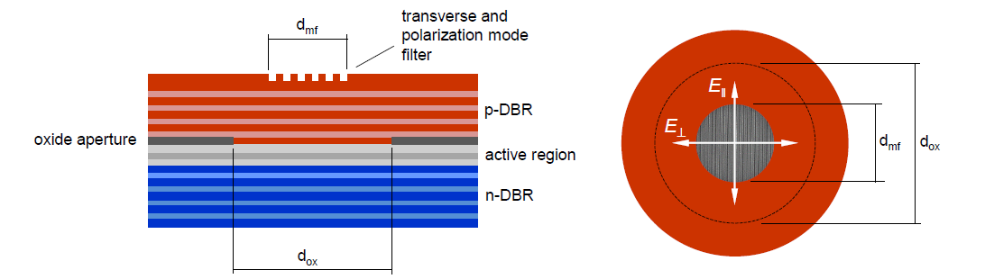
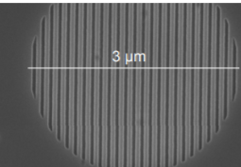
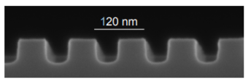
Implementing the linear grating on the top-most DBR mirror
It will also
reduce photon lifetime, which will increase RIN
Grating structure on the topmost DBR layers
ERIK HAGLUND,1,2 MEHDI JAHED,1 JOHAN S. GUSTAVSSON,1 ANDERS LARSSON,1,* JEROEN GOYVAERTS,3 ROEL BAETS,3 GUNTHER ROELKENS,3 MARC RENSING,4 AND PETER O’BRIEN4 Vol. 27, No. 13 | 24 Jun 2019 | OPTICS EXPRESS 18892

Slide 17
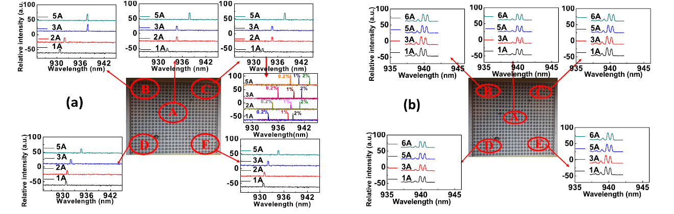
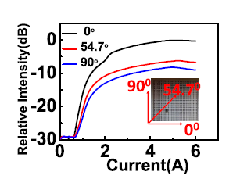
Our solution
Do we have any better solution which can improve RIN without reducing photon lifetime?
Single polarize single mode
QSM
Jin-Wei Shi,1,* Zuhaib Khan,1 Ray-Hua Horng,2 Hsiao-Yun Yeh,2 Chun-Kai Huang,3 Cheng-Yi Liu,3 Jie-Chen Shih,1 Yung-Hao Chang,1 Jia-Liang Yen,4 AND Jinn-Kong Sheu Vol. 45, No. 17 / 1 September 2020 / Optics Letters5

Slide 18
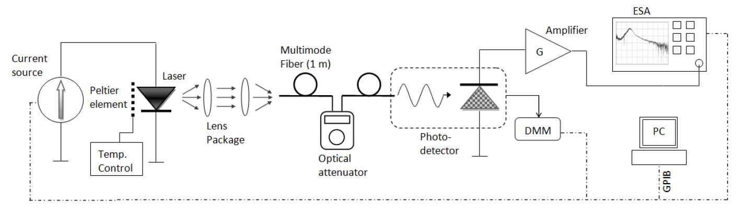
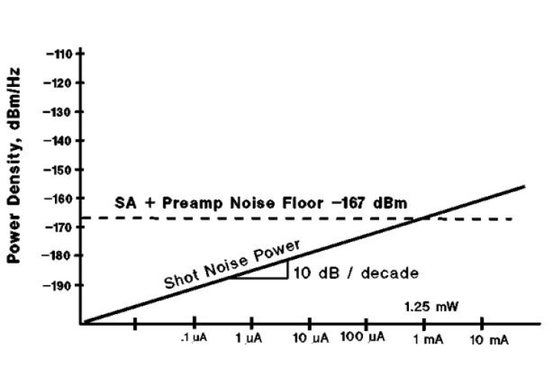
RIN measurement
Setup:
quantum nature of photons arriving at the detector
dark photocurrent of the detector +the thermal noise sources of the electronics (total background noise).
Too small can ignore
 | paper | Ours
D.C SOURCE | Yokogawa 7651 programmable d.c. source | KEITHLEY 2400 2461
RF probe | Picosecond 40A-GSG-100-P from GGB Industries | 67A-GS-125-DP from GGB Industries
Muti-mode fiber | 50 m multi-mode fiber (1 m long) via an AR coated lens package>60% coupling efficiency | 50 m multi-mode fiber (1 m long)>70%coupling efficiency
photodetector | New Focus 1481-S-50 25 GHz fiber-coupled multi-mode detector | VIS D50-1300M HIGH SPEED PHOTODETECTOR MODULE
ESA | Agilent E4440A PSA series electrical spectrum analyzer | Agilent E4407B ESA-E SERIES electrical spectrum analyzer
Amplifer | SHF 115 AP, 20 GHz, SHF 100 AP, 25 GHz | SHF 806E
calculated from the measured dc photocurrent when the laser is turned on
S.-E.Hashemi,”Relative Intensity Noise (RIN) in High-Speed VCSELs for Short Reach Communication,”Master Thesis,Chalmers University of Technology, 2012.

Slide 19
Outline
Introduction & Motivation
Ways to low RIN
Our Achievements
Conclusion and Future Work
Notes:
這是我今天的報告大綱。首先，是發展進程及動機
接著是介紹VCSEL理論及我們元件結構
再來會有IET940nm光波段陣列的量測
然後是聯亞940nm光波段陣列的量測結果及單顆元件量測出的特性
最後為未來展望以及結論的部分

Slide 20
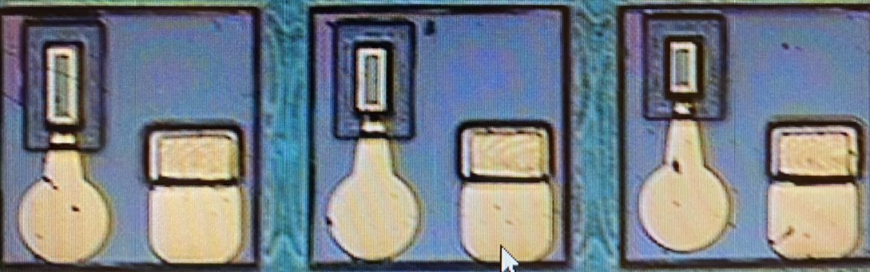
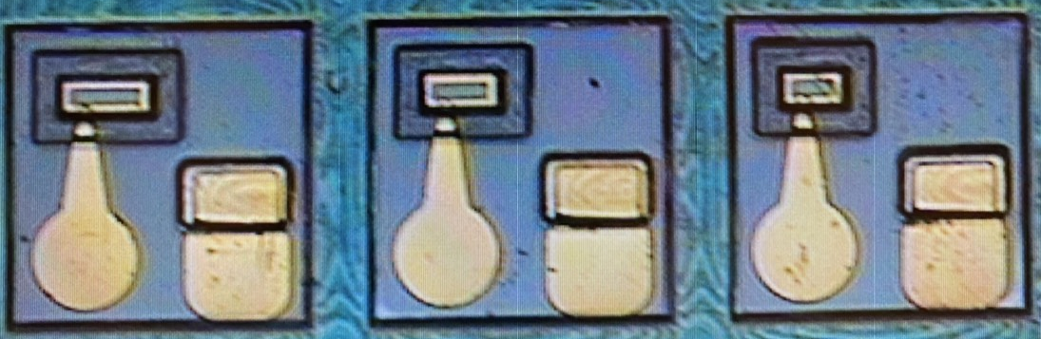
Rectangular Mesa
Pad
P contact
011
011-
Oxide relief
0.5 λ Cavity,
InGaAs/AlGaAs MQW
SiO₂
BCB
W_{O}
N contact
011
Undoped layer
011-
GaAs Substrate
19
19

Slide 21
30*50
011
30*60
30*70
011-
30um
Significant improvement in OPSR~10dB

Slide 22
011
011-
BEFORE low RIN process
30*50
30*60
30*70
Significant improvement in optical spectrum
AFTER low RIN process

Slide 23
011
30*50
011-
30*60
30*70
E-O more flat after low RIN process
E-O frequency response becomes more flat (larger damping)

Slide 24
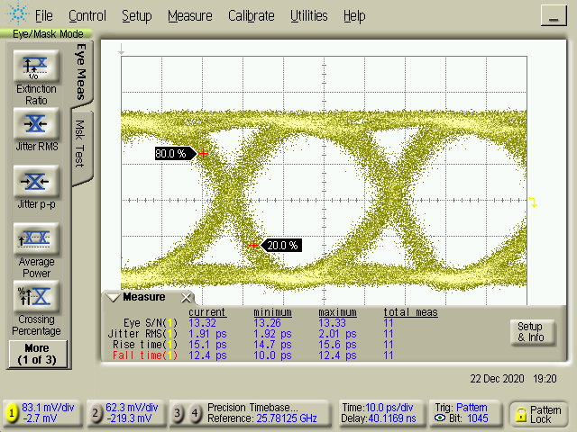
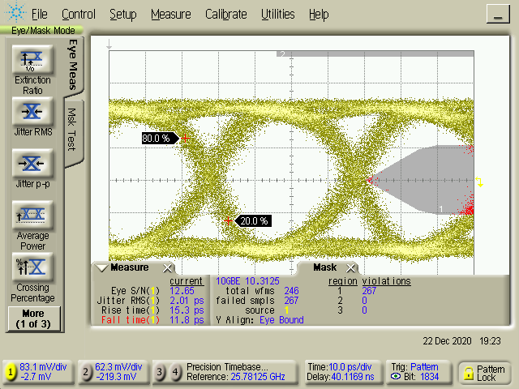
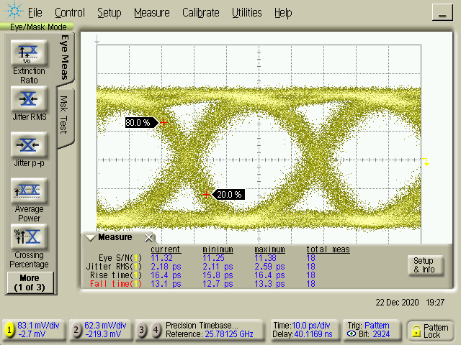
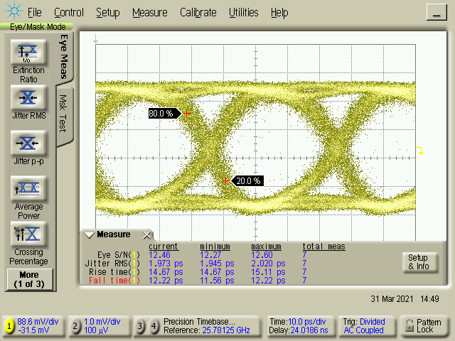
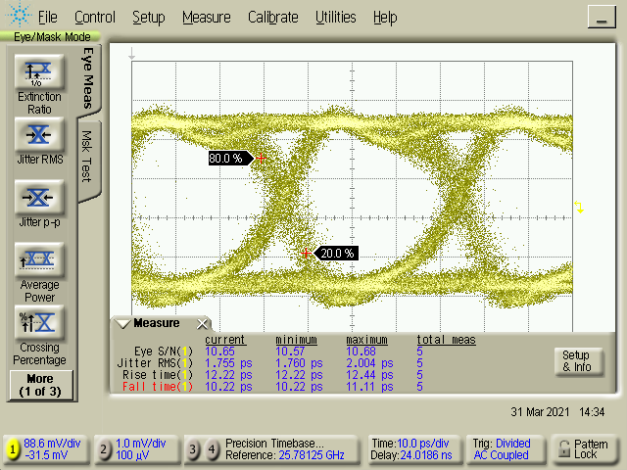
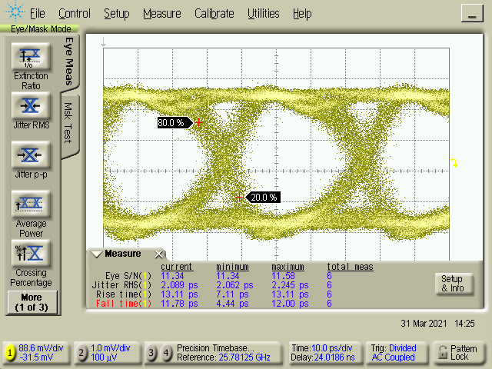
011
Room temperature
BEFORE
011-
30*50 6mA
30*60 8mA
30*70 10mA
Jitter=1.91
Jitter=2.01
Jitter=2.18
30*50 6mA
30*60 8mA
30*70 10mA
Jitter=1.97
Jitter=1.755
Jitter=2.089
Improvement in eye-pattern diagram, with more uniformity (increased yield)
AFTER

Slide 25
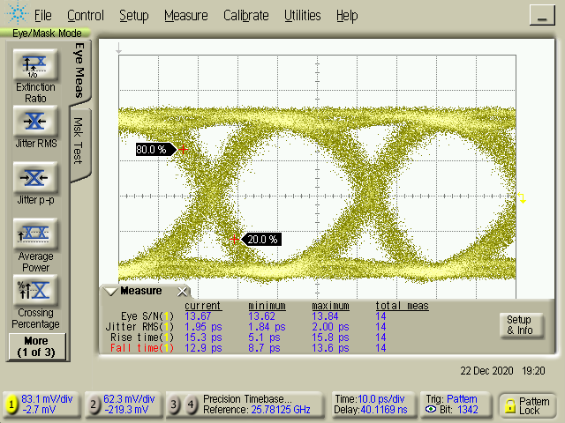
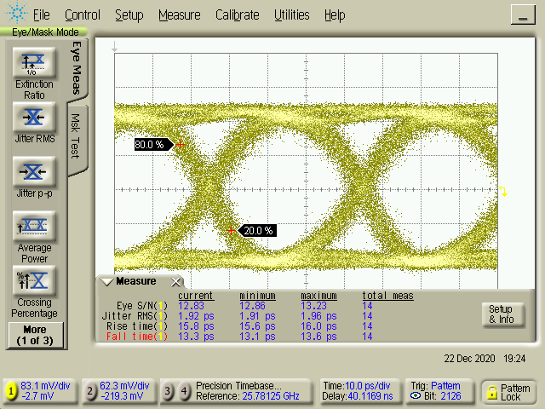
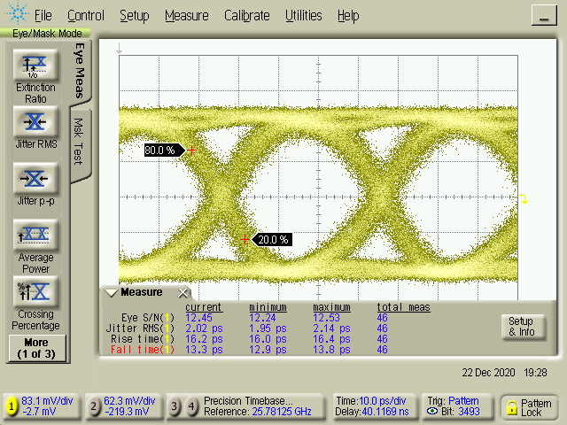
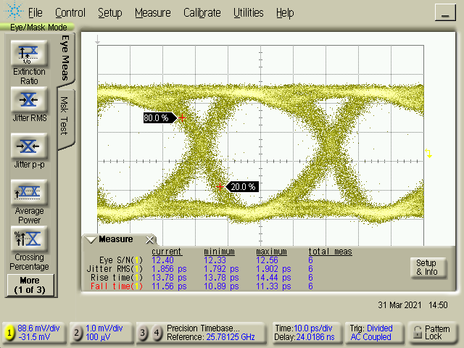
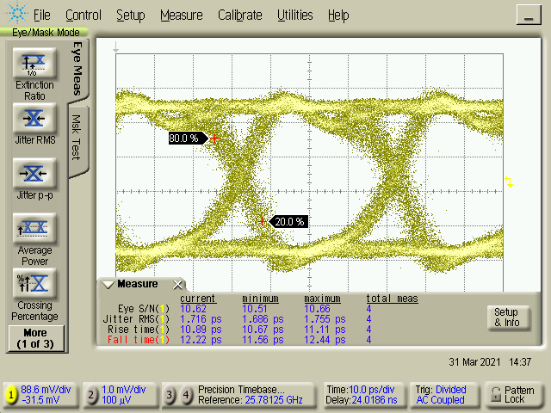
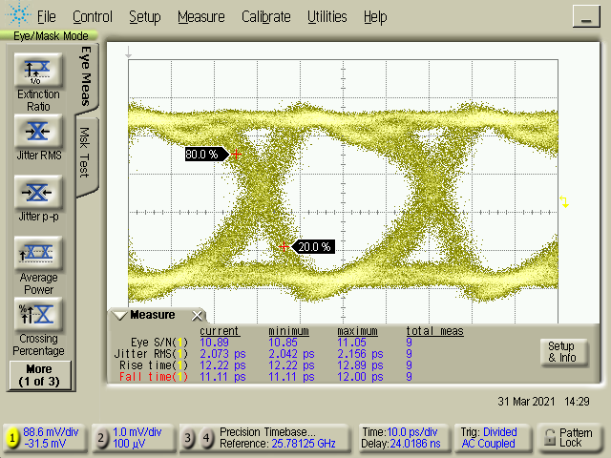
011
Room temperature
BEFORE
30*50 8mA
011-
30*60 10mA
30*70 12mA
Jitter=1.95
Jitter=1.92
Jitter=2.02
30*50 8mA
30*60 10mA
30*70 12mA
Jitter=1.856
Jitter=1.716
Jitter=2.073
Improvement in eye-pattern diagram, with more uniformity (increased yield)
AFTER

Slide 26
011
BEFORE
011-
30*50
30*60
30*70
AFTER
Significant improvement in RIN after low-RIN process

Slide 27
Comparison between rectangular mesa structure and other commercially available devices
011
011-
30*60
After electroplating
Sony vs Ours
Avago vs Ours

Slide 28
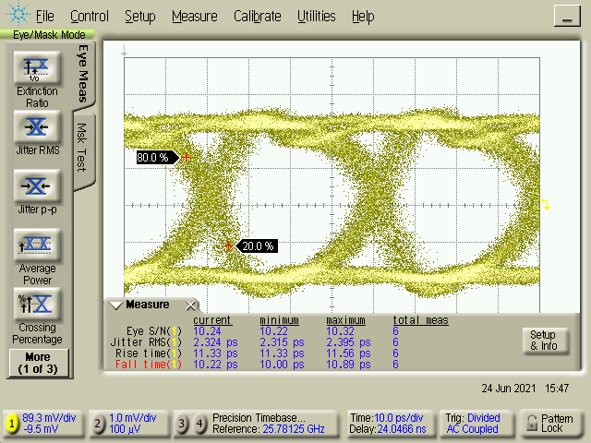
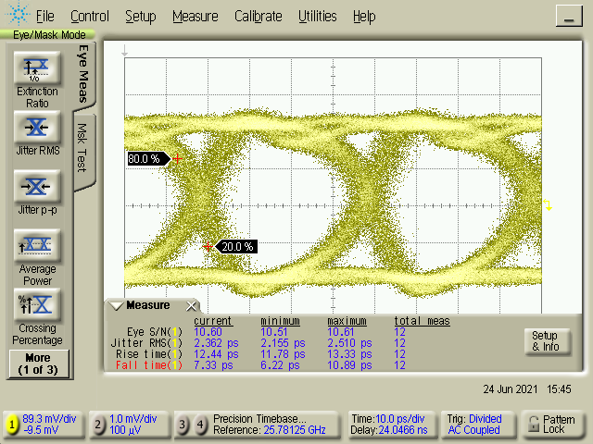
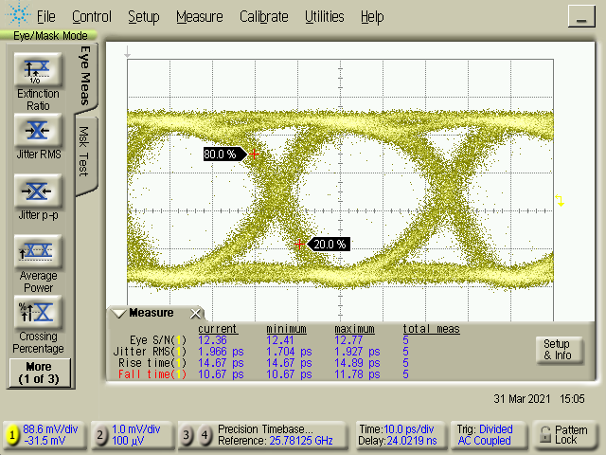
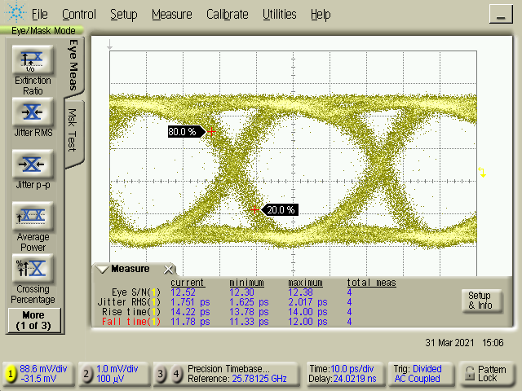
9mA
Jitter=2.324
Comparison between rectangular mesa structure
and other commercially available devices
Sony
12mA
Jitter=2.362
Better eye quality
More flat E-O and lower RIN
8mA
Jitter=1.966
Ours
30*60
Jitter=1.751
10mA
011
011-

Slide 29
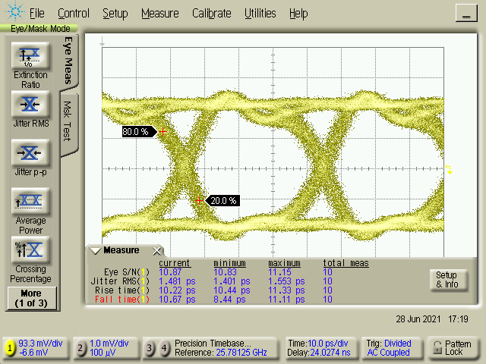
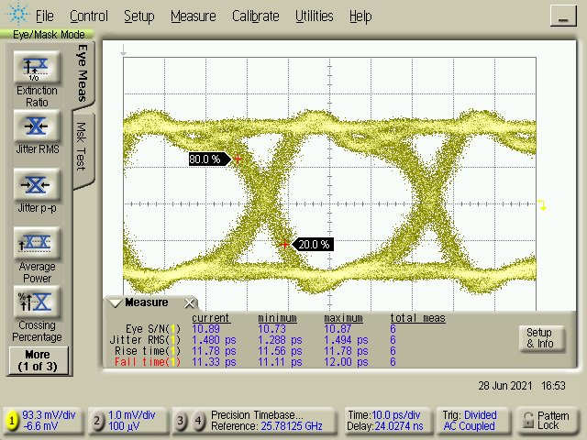
Avago
Comparison between rectangular mesa structure
and other commercially available devices
6mA
Jitter=1.481
More wide and flat E-O
But a little higher RIN
Jitter=1.480
9mA
Eye is decided by
Both E-O and RIN
Ours
8mA
Jitter=1.966
30*60
After electroplating
10mA
Jitter=1.751
011
011-

Slide 30
Newest run (2022 March)
QSM during operation

Slide 31
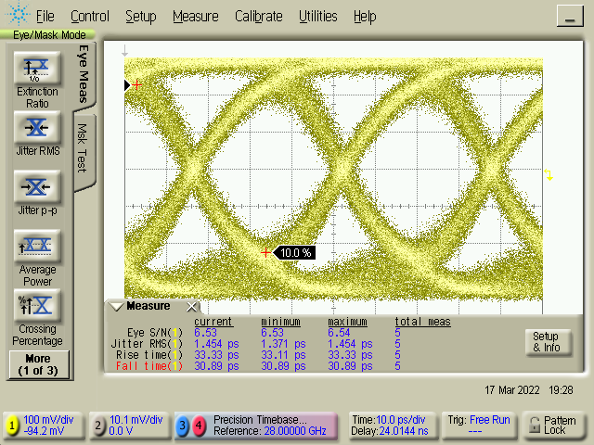

28G Data rate
Avago Ref
25 Gbps
Jitter: 1.48 ps
6mA
8mA
Jitter:1.45
Jitter:1.52

Slide 32


25G Data rate
500m
6mA
8mA
Jitter:2.21
Jitter:2.29
Not possible for Avago one (500 meter 25 G transmission)

Slide 33


28G Data rate
500m
6mA
8mA
Jitter:2.36
Jitter:2.51

Slide 34


32G Data rate
6mA
8mA
Jitter:1.60
Jitter:1.44

Slide 35

32G Data rate
500m
6mA
8mA
Jitter:2.32
Jitter:

Slide 36
Outline
Introduction & Motivation
Ways to low RIN
Our Achievements
Conclusion and Future Work
Notes:
這是我今天的報告大綱。首先，是發展進程及動機
接著是介紹VCSEL理論及我們元件結構
再來會有IET940nm光波段陣列的量測
然後是聯亞940nm光波段陣列的量測結果及單顆元件量測出的特性
最後為未來展望以及結論的部分

Slide 37

Future work
Send VCSEL 1*4 array to UMEC for package
Selling points: 25 Gbps for 500 m transmission

Slide 38

Future work
Discuss with Unikorn for VCSEL IP license and foundry service issues

Slide 39
Conclusion
State-of-the-art low RIN and Quasi-SM high-speed VCSEL is ready for pioneer run at foundry
Package for system level test and IP licenses are both important issues now
Toward 112 Gbit/sec (56 Gbaud PAM-4), QSM, and low RIN VCSEL (Wo: ~7 um)

Slide 40
Thank you for your attention

